Slide 1
Overview of SUM, AVR, and Aggregate features:
Aim:
Tableau Calculations, Overview of SUM, AVR, and Aggregate features, Creating custom calculations and fields
Solution :
Tableau offers a powerful set of calculation tools that allow us to manipulate, transform, and analyze our data in various ways.
Here's an overview of some key concepts related to Tableau calculations, including SUM, AVG (average), and aggregate functions, as well as creating custom calculations and fields
SUM and AVG (Average) Functions
The SUM function in Tableau calculates the total sum of a numeric field.
We can use it to find the sum of values in a column or as part of a more complex calculation.

Slide 2
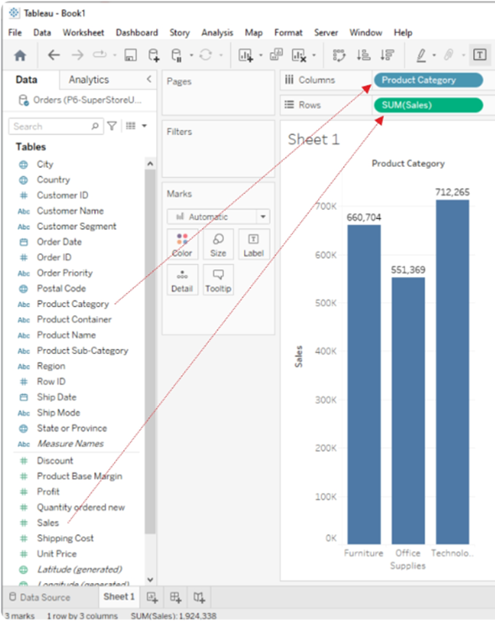

Slide 3
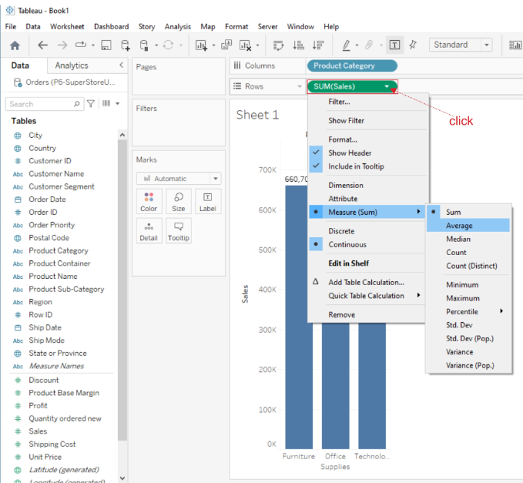
AVG (Average) Function
The AVG function calculates the average (mean) value of a numeric field.
Like SUM, we can use it by dragging a numeric field into the "AVG" shelf or creating a calculated field with the AVG function.

Slide 4
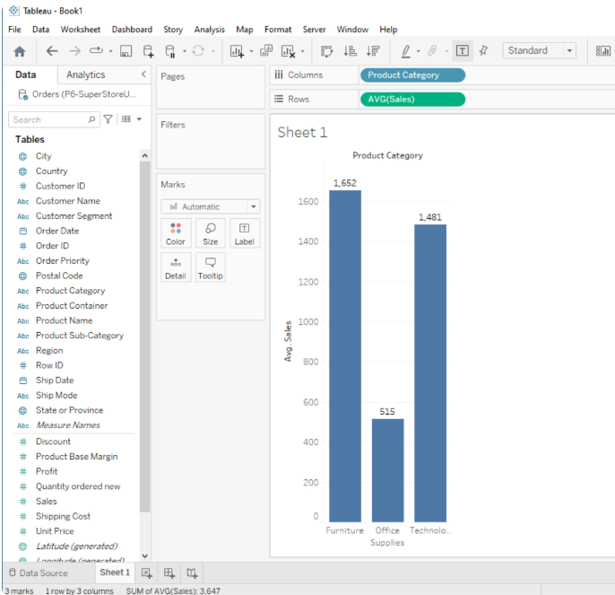

Slide 5
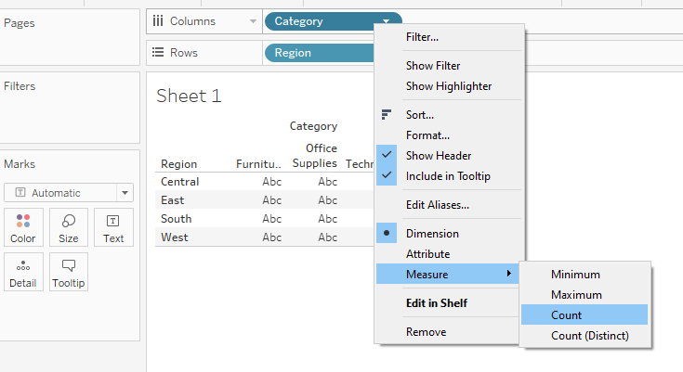
Aggregate Functions:
Tableau provides a range of aggregate functions that allow us to perform calculations on groups of data.
Common aggregate functions include SUM, AVG, COUNT, MIN (minimum value), and MAX (maximum value).
These functions are particularly useful when you want to analyze data at different levels of granularity (e.g., by category, region, or time period).
Ex:
Place category on Column
Place Region on Row

Slide 6
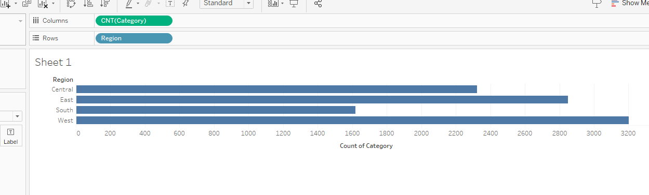
the minimum sales for each subcategory

Slide 7
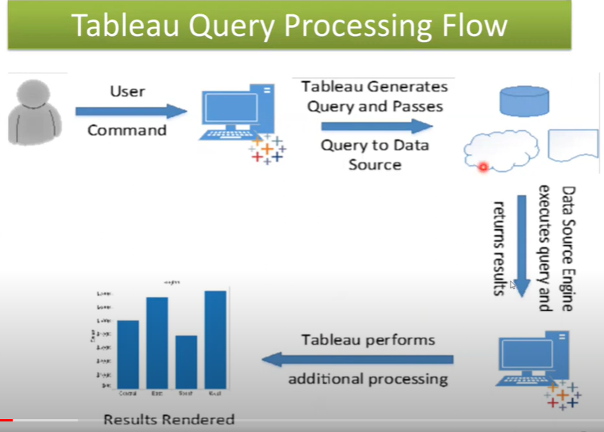

Slide 8
Types of Calculation in Tableau:
Row Level Calculation
Aggregate Level Calculations
Level of Detail Calculations
Table level Calculations

Slide 9
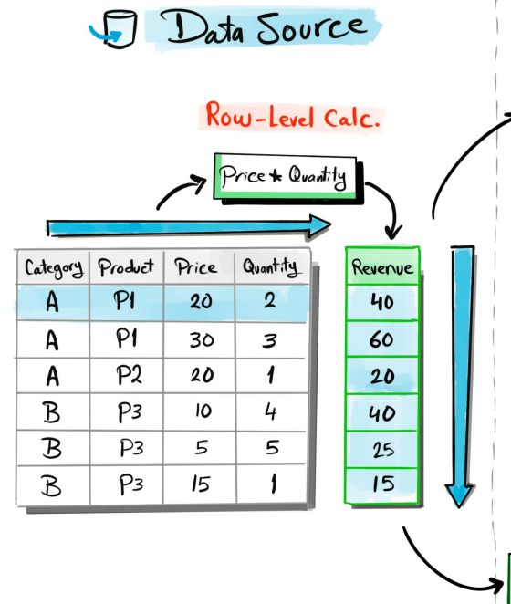
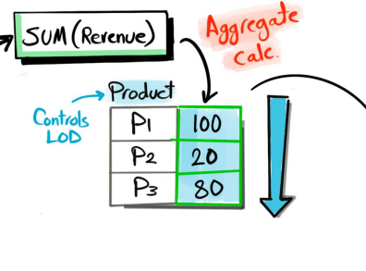
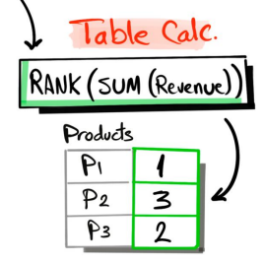
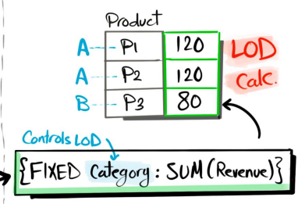

Slide 10

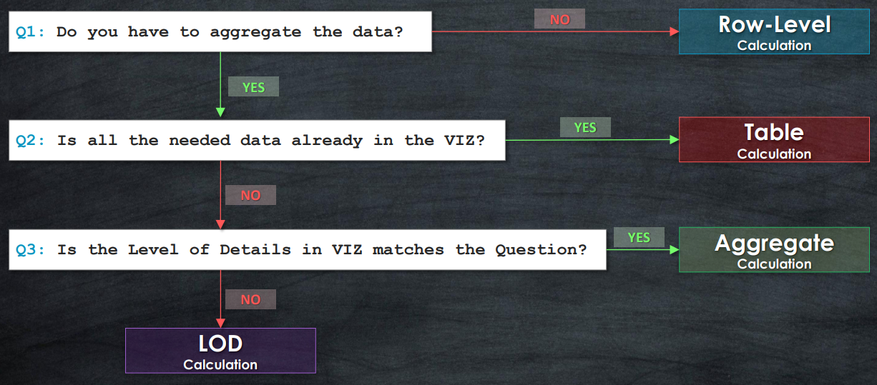

Slide 11
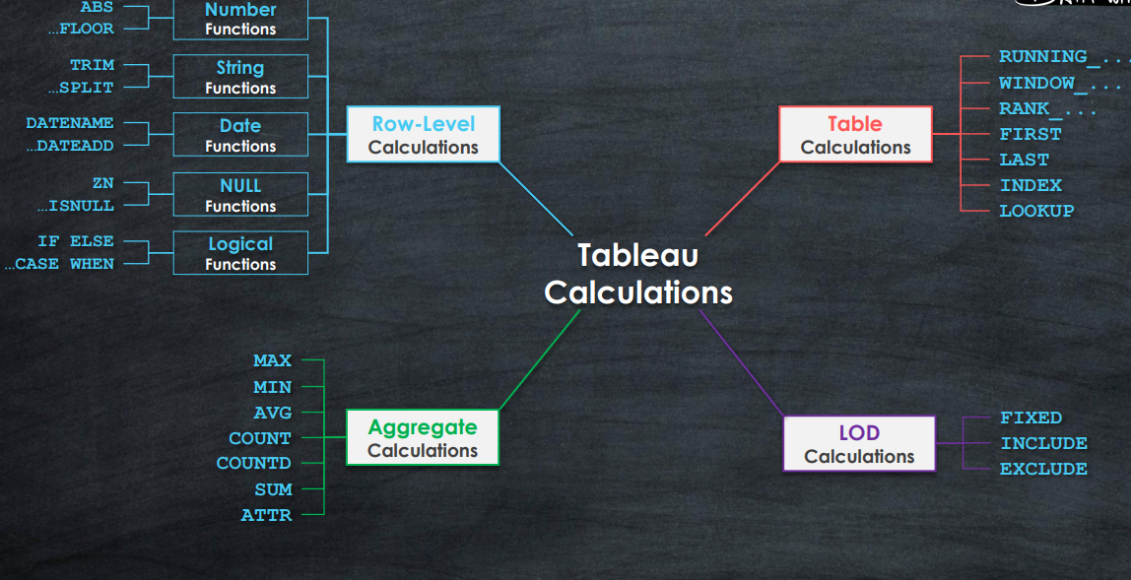

Slide 12
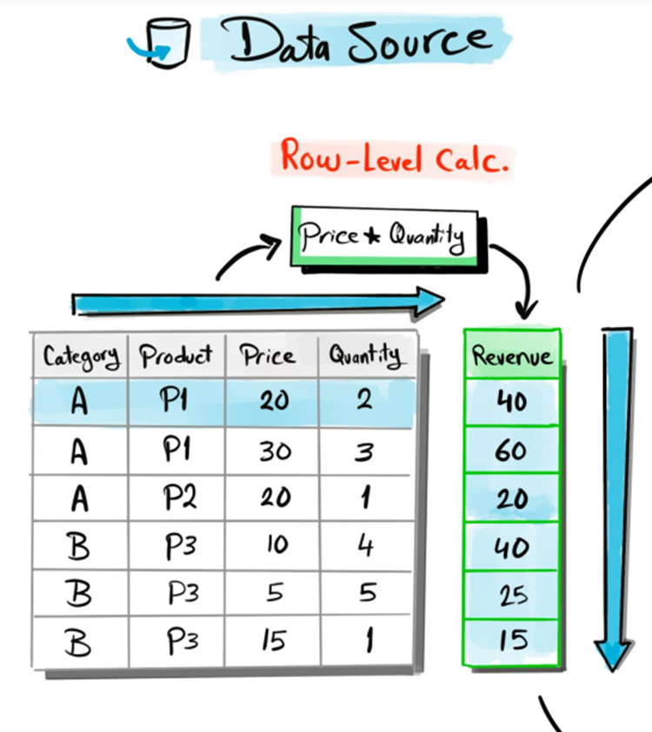
Row Level Calculation:
Perform calculations at the row level individually.
Level of Details is the Data Source Rows
Data will not be aggregated
The calculations are performed on the data within the data source
Calculation results will be stored in Data source and will not be calculated on the FLY.

Slide 13
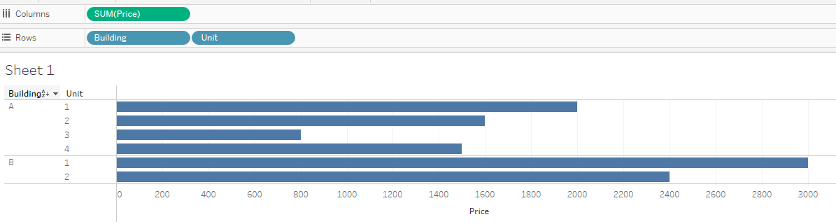
Ex: Consider Apartment Rental data source: Data set has 6 parameters, the occupant, start and End dates of rental period, the area (in Square feet) and monthly rental price.
Here apartment actually has the building and the unit number.
i.e. Ex: A-2 is unit 2 in building A.
Here, create 2 calculated fields:
Building : Split([Apartment],”-”,1)
Unit : Split([Apartment],”-”,2)
These fields are show up in the data pane, under dimensions.
In View:
Drag Price on column
Building and unit in Rows

Slide 14
Here, any unit number 1 or 2 is downstairs, while 3 or 4 are upstairs. You would like to have that information for analysis purpose:
Then create one more field “ Floor”

Slide 15
Then create one more field “ Floor” by using
if Int([Unit])>2
then “Upstairs”
Else “Down stairs”
END
IF INT([ Unit])=1 or INT([ Unit])=2
THEN "Downstairs"
ELSEIF INT([ Unit])=3 or INT([ Unit])=4
THEN "upstairs"
ELSE "Unknown"
END

Slide 16
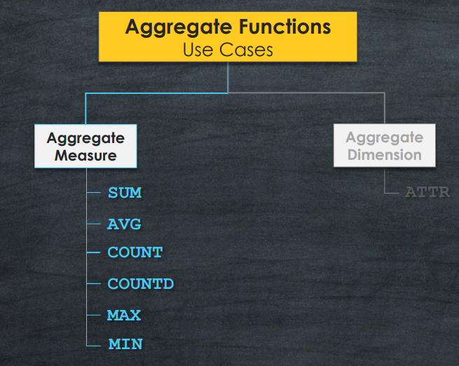
Aggregate Level Calculations
Aggregate the rows at the dimension level used in the VIZ
Level of Details is the Visualization | VIZ LOD
The calculations are performed on the data within the data source
Results will be calculated on the FLY

Slide 17
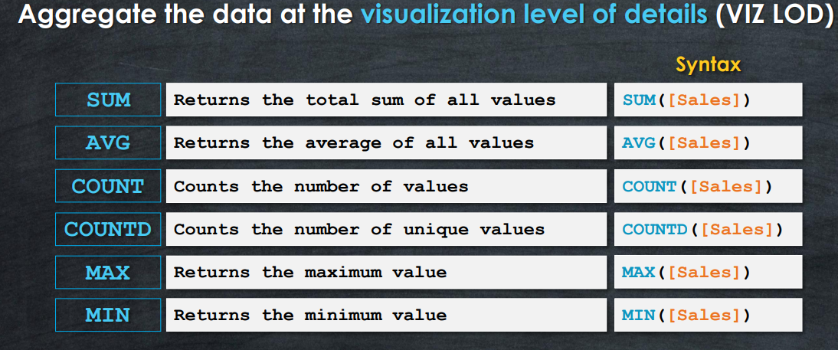
Note: Aggregate Calculation depends on dimensions to define the level of detail at which the calculation is performed.

Slide 18
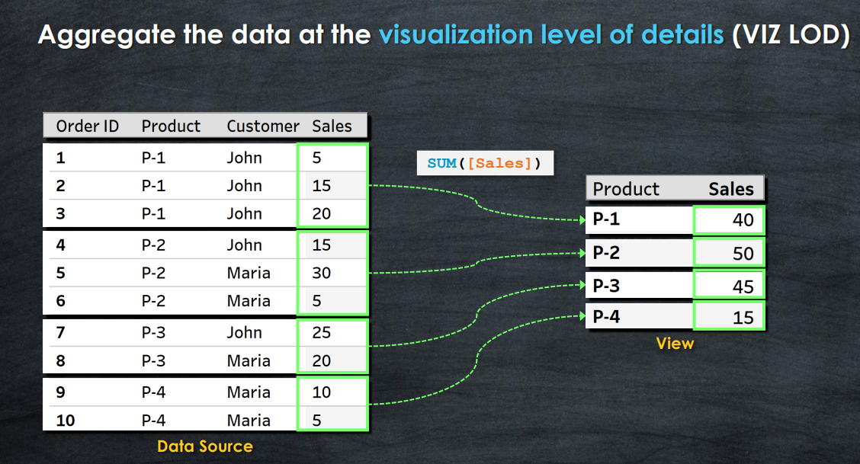

Slide 19
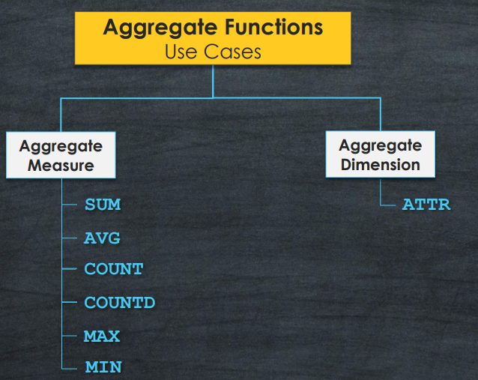

Slide 20
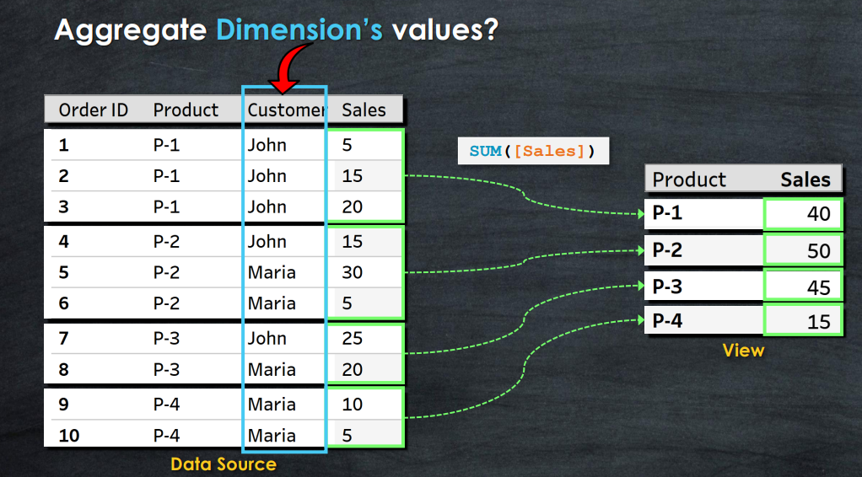

Slide 21
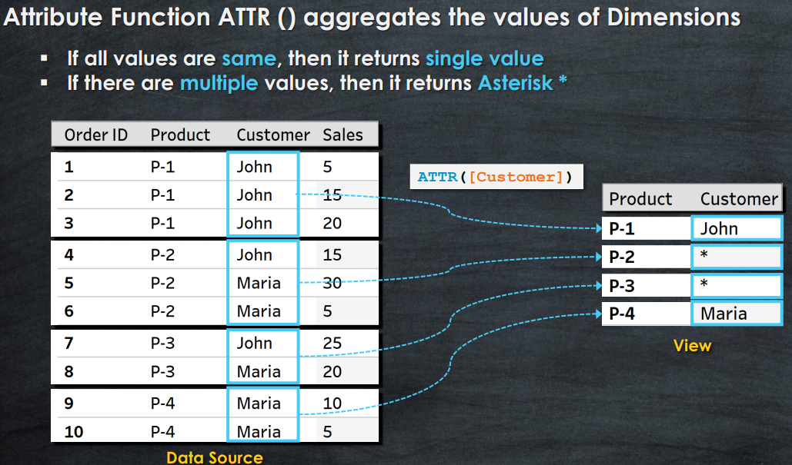

Slide 22
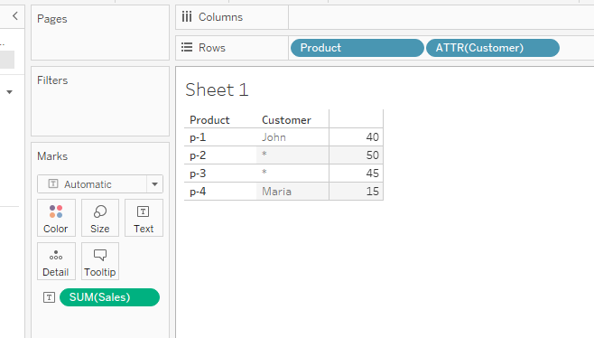
When adding dimensions to the Tooltip, Tableau automatically wraps them in the ATTR() aggregation so the added field does not change the viz Level of Detail.
Drag that field in to Row Shelf.
(OR) Drag Customer on Row shelf and right Click on it and click on Attribute

Slide 23
Ex: in Apartment Rental ,
Display price per square foot by building and floor
This is not available in Data Source. It must be calculated at an aggregate Level.

Slide 24
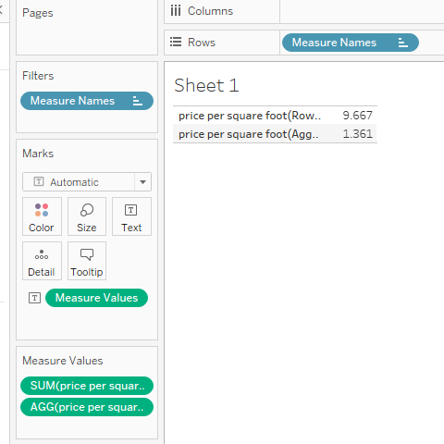
Row Level or Aggregate- Why does it matter ?
What if you create a calculated field named “price per square foot(Row level)” with following code:
[Price] / [Area]
The code differ from the calculated field named “Price per Square foot (Aggregated)” :
SUM[Price] / SUM[Area]
Why there is such a
Difference in the result?

Slide 25
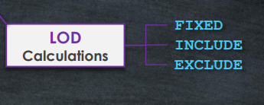
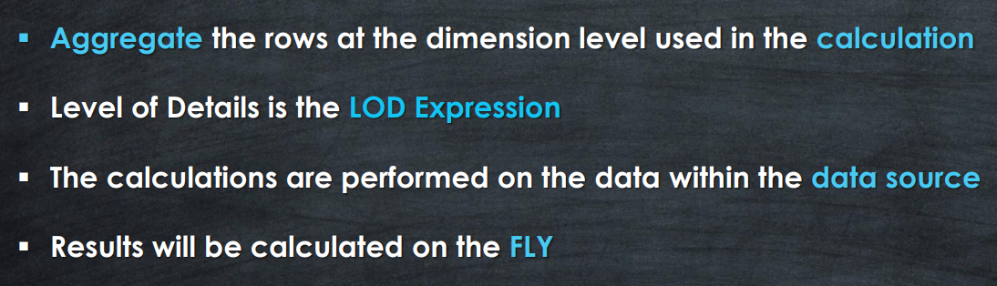
Level of Detail Calculations
It allows us to perform aggregations
at a specified level of detail, which may
be different from the level of detail defined in the view

Slide 26
Types of LOD
There are three main types of LOD expressions.
FIXED LOD This expression computes values using the specified dimensions without reference to any other dimensions in the view.
INCLUDE LOD This level of detail expressions compute values using the specified dimensions in addition to whatever dimensions are in the view.
EXCLUDE LOD These levels of detail expressions subtract dimensions from the view level of detail.

Slide 27
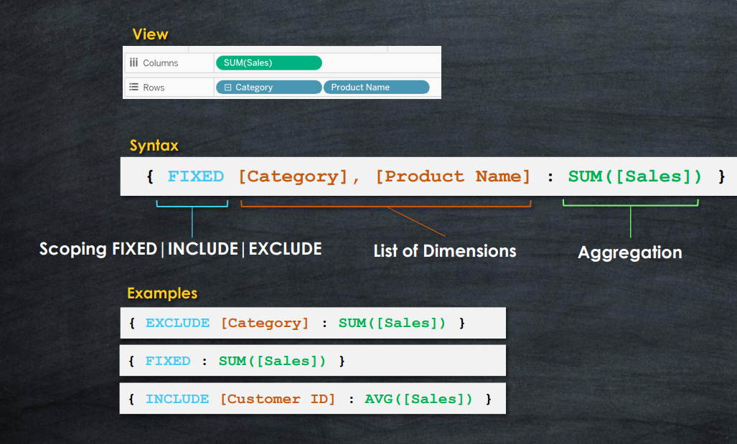
Syntax: { [TYPE] [Dimension1], [Dimension2] : AGG([Measure])
Here dimensions define the level of detail at which the calculation will be performed
AGG is the aggregate function wish to perform and
Measure is the field that will be aggregate by aggregate function.

Slide 28
Fixed: Aggregate at the level of detail specified by the list of dimensions in the code regardless of what dimensions are in the view.
Ex: following code returns the average price per Floor:
{FIXED [Floor] : AVG([Price])
Include: Aggregated at the level of detail determined by the dimensions in the view and the dimensions listed in the code.
Ex: average price at the level of detail defined by dimensions in the view, but includes the dimension “occupant Last” name , if it is not in the view.
{ INCLUDE [Occupant Last Name ] : AVG([Price]) }
Exclude:
Average price at the level of detail defined in the view, but does not include the apartment dimension as a part of the level of detail , even if it is in the view
{EXCLUDE [Apartment] :Avg([Price])

Slide 29
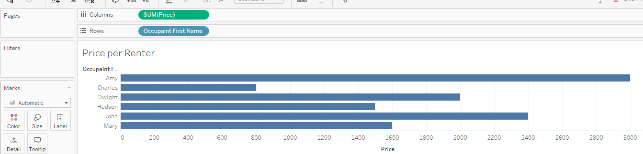
Ad hoc Calculations:
Ad hoc calculations add calculated field to shelves in a single view without adding fields to the data pane.
Here we have price for Renter.
What if we want to quickly highlight any renter who had a contract of at least $2000?
One option is create ad hoc calculation.

Slide 30
To do so, simply double click on an empty area of the columns, Rows, or Measure values card, or on the empty space of the Marks shelf, and then type the code for calculation.
Ex: double click on Marks shelf, write
SUM([Price]) >=2000
It return true if the sum(price) is >2000 otherwise return false.
Pressing Enter or clicking outside the text box will reveal a new ad hoc field that can be dragged and dropped anywhere within the view.
Here added it to the color shelf.
Note: Ad hoc field does not show up in the Data pane.it is available within the View only.

Slide 31
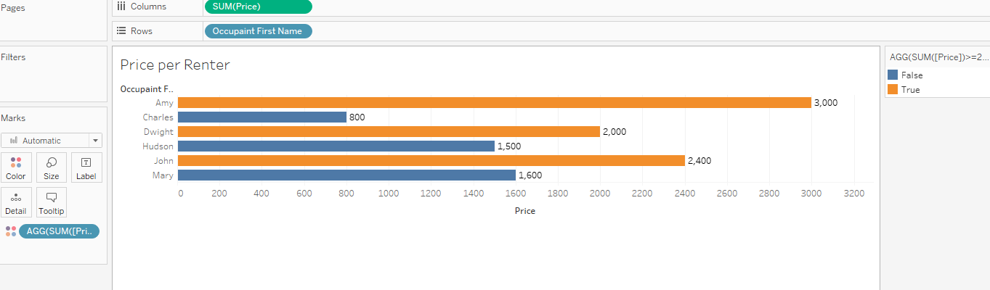

Slide 32
To understand this LOD Tableau expression, you can go through a case of comparing the average customer sales across different product segments.
AVG({INCLUDE [Customer Name] : SUM([Sales])})

